Slide 1
Chapter - 3
Object Oriented Design

Slide 2
Analysis to Design
The requirement study & OOA focuses on learning to “do the right thing” i.e. understanding some of the goals for the problem domain
By contrast, the design work stresses “ do the right thing”, that is, skillfully designing a solution to satisfy the requirements.
If we follow UP guidelines, perhaps 10% of the requirements were investigated during inception & slightly deeper investigation in first iteration of elaboration.
Then further emphasis towards designing a solution for this iteration in terms of collaborating software objects.

Slide 3
Here in each iteration, the focus from requirement analysis is shifted to the design.
These discoveries will both clarify the purpose of the design work of this iteration &
Refine the requirements understanding for future iterations.
Over the course of these early elaboration iterations, the requirement discovery will stabilize.
So, by the end of elaboration perhaps 80% of the requirements are reliably defined in detail.

Slide 4
OOD
OOD transforms the analysis model created using OOA into a design model that serves as a blueprint for software construction.
OOD results in a design that achieves a number of different levels of modularity.
Subsystems: Major system components.
Objects: Data and the operations.
Four important software design concepts:
Abstraction
Information Hiding
Functional Independence
Modularity

Slide 5
The transition from analysis oriented work to design preparation is based on the several architectural layers such as
UI layer,
Application logic & domain objects
Technical services
Called logical architecture.

Slide 6
Layers shown with UML packaged diagram
UI
Swing
Web
Domain
Sales
Payments
Taxes
Technical services
Persistence
logging
Rule engine

Slide 7
Logical architecture is the large scale organization of the software classes into packages, subsystems & layers.
The next step is to move towards the object design.
On the object design, 1st step is to create interaction diagrams( a dynamic model), which illustrates how object collaborate to fulfill requirements.
Then design of class diagrams is drawn.

Slide 8
In practice, design of interaction & class diagrams happens in parallel and synergistically.
These summarize the definitions of software classes & interfaces that are implemented in software.
In the UP , these two artifacts represented by UML diagrams become a part of design model.

Slide 9
Of the two artifacts, interaction diagrams are more important from the point of view of developing a good design and requires a greatest degree of creative effort.

Slide 10
UP Artifacts
Requirements
Business Model
Op. Contract
Starting events
Method( )
Operation
Post-conditions
Domain Model
Sys. Seq. Diagram
Use Case
Suggestions for names
Title
…
…
Functional
requirements
method1( )
method2( )
method3( )
Item details
Glossary
Interaction Diagrams
Domain rules
Non-functional
requirements
Supplementary
Specification
Design Class Diagram
Design Model

Slide 11
3.2 Describing & Elaborating Use Cases

Slide 12
Real and Essential use cases
Use case degree of design commitment
Essential use case very abstract real very concrete
Essential use case:
very abstract
Real use case:
very concrete
Essential use cases
- created during early stage of eliciting the requirements
- independent of the design decisions
Real use cases
- Describe the functionality of the system in terms of its actual current design committed to specific input output technologies
- Developed only after the design decisions have been made
- Design artifacts

Slide 13
Real vs Essential Use Case
Essential use case
Actor action System response
1. customer identifies themselves 2. Provide Customer with options
3. ……
Real use case
Actor action System response
1. customer inserts their cards 2. Prompts for PIN
3. enters PIN on key pad 4. Displays option menu
……………..

Slide 14
Buy Items use case
Essential
Actor action System response
1. cashier records identifier for each item 2. Determine the item price and add the item info
If there is more than one of the same to the running sales transaction description
The cashier enters quantity price of the current item in item presented
Real
1. For each item cashier types UPC 2. Display item price and add the item information
In the UPC input field of window then to the running sales transactions the description
They press “enter item” button and price of current item are displayed
with the mouse or keyboard

Slide 15
Elaboration of ATM Use Case
Use Case Name : Withdraw Funds
Summary : Customer uses a valid card to withdraw funds from a valid bank account.
Actor : ATM Customer
Precondition : ATM is displaying the idle welcome message
Description :
– Customer inserts an ATM Card into the ATM Card Reader.
– If the system can recognize the card, it reads the card number.
– System prompts the customer for a PIN.
– Customer enters PIN.
– System checks the card's expiration date and whether the card has been stolen
or lost.
– If the card is valid, the system checks if the entered PIN matches the card PIN.
– If the PINs match, the system finds out what accounts the card can access.
– System displays customer accounts and prompts the customer to choose a
type of transaction.
There are three types of transactions, Withdraw Funds, Get Balance are part of all three use cases;

Slide 16
Elaboration of ATM Use Case – (2/3)
Description (continued) :
– Customer selects Withdraw Funds, selects the account number, and enters the
amount.
– System checks that the account is valid, makes sure that customer has enough
funds in the account, makes sure that the daily limit has not been exceeded,
and checks that the ATM has enough funds.
– If all four checks are successful, the system dispenses the cash.
– System prints a receipt with a transaction number, the transaction type, the
amount withdrawn, and the new account balance.
– System ejects card.
– System displays the idle welcome message.

Slide 17
Elaboration of ATM Use Case – (3/3)
Alternatives :
– If the system cannot recognize the card, it is ejected and the welcome message is displayed.
– If the current date is past the card's expiration date, the card is confiscated and the welcome message is displayed.
– If the card has been reported lost or stolen, it is confiscated and the welcome message is displayed.
– If the customer entered PIN does not match the PIN for the card, the system prompts for a new PIN.
– If the customer enters an incorrect PIN three times, the card is confiscated and the welcome message is displayed.
– If the account number entered by the user is invalid, the system displays an error message, ejects the card and the welcome message is displayed.

Slide 18
Elaboration of ATM Use Case – (3/3)
– If the request for withdraw exceeds the maximum allowable daily withdrawal amount, the system displays an apology message, ejects the card and the welcome message is displayed.
– If the request for withdraw exceeds the amount of funds in the ATM, the system displays an apology message, ejects the card and the welcome message is displayed.
– If the customer enters Cancel, the system cancels the transaction, ejects the card and the welcome message is displayed.
Postcondition :
Funds have been withdrawn from customer's account.

Slide 19
Interaction diagram
As already mentioned after logical layered architecture is developed the next step on to the object design is to draw UML interaction diagram.
They are used for dynamic object modeling.
The term interaction diagram, is a generalization of two more specialized UML diagram types;
Both can be used to express similar message interactions:
- Communication/Collaboration diagrams
Sequence diagrams

Slide 20
Buy Item-version 1
:System
enterItem (UPC, qty)
enterItem
Operation : enterItem
Post-conditions
If a new sale, a new sale created.
endSale
:Register
makePayment
Contract
Collaboration Diagram
System Sequence Diagram

Slide 21
For any kind of UML element (class, actor, ...), an instance uses the same graphic symbol as the type, but the designator string is underlined.
To show an instance of a class in an interaction diagram, the regular class box graphic symbol is used, but the name is underlined.
A name can be used to uniquely identify the instance. If none is used, a ":" precedes the class name.
The UML has adopted a simple and consistent approach to illustrate instances vs. classifiers:

Slide 22
Common Interaction Diagram Notation

Slide 23
Basic message expression to syntax
Interaction diagram shows messages between objects;
The UML has a standard syntax for these message expressions
return := message(parameter : parameterType) : returnType
Type information may be excluded if obvious or unimportant.
For example:
spec := getProductSpect(id)
spec := getProductSpect(id:ItemID)
spec := getProductSpect(id:ItemID) ProductSpecification

Slide 24
3.3 Collaboration Diagrams

Slide 25
Basic collaboration(communication) diagram notation
Links
A link is a connection path between two objects; it indicates some form of navigation and visibility between the objects is possible
More formally, a link is an instance of an association.
For example, there is a link or path of navigation from a Register to a Sale, along which messages may flow, such as the makePayment message.

Slide 26
Basic Collaboration Diagram Notation

Slide 27
Messages
Each message between objects is represented with a message expression and small arrow indicating the direction of the message.
Many messages may flow along this link .
A sequence number is added to show the sequential order of messages in the current thread of control.

Slide 28
Basic Collaboration Diagram Notation

Slide 29
Messages to "self" or "this"
A message can be sent from an object to itself , illustrated by a link to itself, with messages flowing along the link.

Slide 30
Basic Collaboration Diagram Notation
msg1()
:Register
1: clear()

Slide 31
Creation of Instances
Any message can be used to create an instance , but the convention in the UML to use a message named create for this purpose ( some use new).
If another (perhaps less obvious) message name is used, the message may be annotated with a special feature called a UML stereotype, like so: «create».
The create message may include parameters, indicating the passing of initial values. e.g. a constructor call with parameters in Java.
The UML property {new} may optionally be added to the instance box to highlight the creation

Slide 32
Basic Collaboration Diagram Notation
<<create>>

Slide 33
Message number sequencing
The order of message is illustrated with sequence numbers
E.g. 1: msg

Slide 34
Conditional Messages
A conditional message is shown by following a sequence number with a conditional clause in square brackets, similar to an iteration clause.
The message is only sent if the clause evaluates to true.

Slide 35
Conditional Messages
msg1()
1 [color=red] :calculate() →
:Foo
:Bar
Conditional Message with Test

Slide 36
Iteration or looping
A common algorithm is to iterate over all the members of a collection(such as list or map), sending the same message to each.
Iteration notation: If the details of the iteration clause are not important to the modeler, a simple ’*’ can be used.

Slide 37
Iteration or Looping
Iteration is indicated with a * and an optional iteration clause following the sequence number
runSimulator()
:Simulator
1 *[ i :=1..N]:num=nextInt()
:Random

Slide 38
Mutually Exclusive Conditional Paths
The example illustrates the sequence numbers with mutually exclusive conditional paths.

Slide 39
Mutually Exclusive Conditional Paths
:ClassE
Unconditional after either msg2 or msg4
2:msg6()
msg1()
:ClassA
1a [test]: msg2()
:ClassB
1a & 1b are mutually exclusive conditional paths
1a.1: msg3()
1b [not test1] :msg4()
:ClassD
1b.1: msg5()
:ClassC

Slide 40
Mutually Exclusive(not occurring at the same time) Conditional Paths
Path letter. The first letter used is a by convention.
Example:
Either 1a or 1b could execute after msg1. Both are sequence number 1 since either could be the first internal message.
Note that subsequent nested messages are still consistently prepended with their outer message sequence. Thus Ib. 1 is nested message within Ib.

Slide 41
Mutually Exclusive Conditional Paths
:ClassE
Unconditional after either msg2 or msg4
2:msg6()
msg1()
:ClassA
1a [test]: msg2()
:ClassB
1a & 1b are mutually exclusive conditional paths
1a.1: msg3()
1b [not test1] :msg4()
:ClassD
1b.1: msg5()
:ClassC

Slide 42
The order of messages is illustrated with sequence numbers.
The numbering scheme is:
1. The first message is not numbered. Thus,msg1() is unnumbered.
2. The order and nesting of subsequent messages is shown with a legal numbering scheme in which nested messages have a number appended to them.
Nesting is denoted by prepending the incoming message number to the out going message number.

Slide 43
Message Number Sequencing
Not numbered
msg1()
1: msg2() →
:ClassA
:ClassB
1.1: msg3()
Legal numbering
:ClassC

Slide 44
Message Number Sequencing
First
Second
msg1()
Third
1: msg2() →
:ClassA
:ClassB
1.1: msg3()
Fifth
2.1: msg5()
2: msg4() →
1.1: msg3()
:ClassC
Fourth
2.2: msg6()
Sixth
:ClassD

Slide 45
Iteration over collection(multiobject)
A common algorithm is to iterate over all members of a collection (such as a list or map), sending a message to each.
Often, some kind of iterator object is ultimately used, such as an implementation of java.util.Iterator or a C++ standard library iterator.
In the UML, the term multiobject is used to denote a set of instances .a collection.
The "*" multiplicity marker at the end of the link is used to indicate that the message is being sent to each element of the collection, rather than being repeatedly sent to the collection object itself.

Slide 46
Iteration Over a Collection (Multiobject)
These two * symbols used together imply iteration over multiobject and sending the getSubtotal message to each member
Double box indicates a multiobject collection for example a list containing many saleLineItems
t:= getTotal()
:Sale
:salesLineItem
1 *:st:=getSubTotal() → *

Slide 47
Message to a class object
Messages may be sent to a class itself, rather than an instance, to invoke class or static methods.
A message is shown to a class box whose name is not underlined, indicating the message is being sent to a class rather than an instance .

Slide 48
Messages to a Class Object
Message to a class or a static method call
msg1()
:instanceOfFoo
list :=synchronizedList(aList)
Java.Util.collections
Not underlined therefore Class

Slide 49
The collaboration diagram is read as follows:
1. The message makePayment is sent to an instance of a Register. The sender is not identified.
2. The Register instance sends the makePayment message to a Sale instance.
3. The Sale instance creates an instance of a Payment.

Slide 50
Collaboration Diagram
1:makePayment(cashTendered)
makePayment →
:POST
:Sale
First internal Message
parameter
1.1: create(cash Tendered)
Link line
Creation indicated with a create message
: Payment

Slide 51
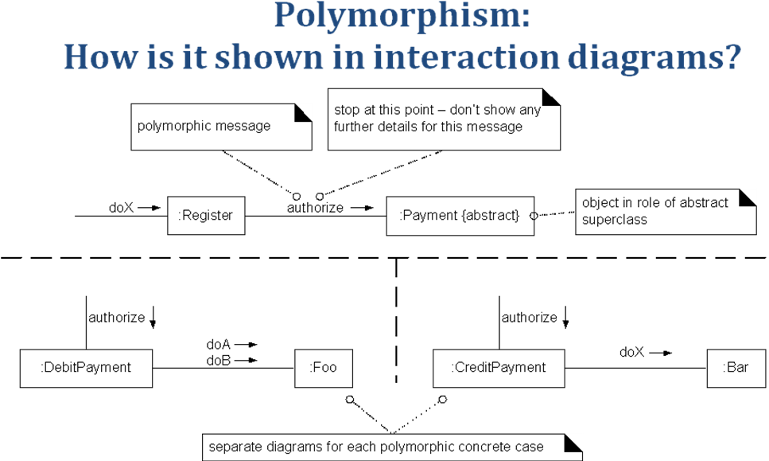
Polymorphism?

Slide 52
Determining Visibility
Sale
Captured on
Register
Produce Catalogue
timeStamp
Domain Model
Process Sale
Customer arrives
Cashier makes new sale….
conceptual
classes in
the
domain
inspire the
names of
some
software
classes in
the design
makeNewSale( )
Process Sale
System Events
Cashier
enterItem(id,quantity )
Use Case
Use Case Model
Sys. Seq. Diagram
Use Case Diagrams
:Register
:ProductCatalogue
makeNewSale( )
create( )
:Sale
enterItem(id,quantity )
spec:=getSpecification(id)
addLineItem(spec, quantity)
the design
classes
discovered
while designing
UCRs can be
summarized in
class diagrams
Register
ProductCatalogue
1
1
makeNewSale( )
getSpecification( )
enterItem(id,quantity )
Design Model
…………………..

